Slide 1

Node.js
Chapter 1 – What is Node.js?

Slide 2
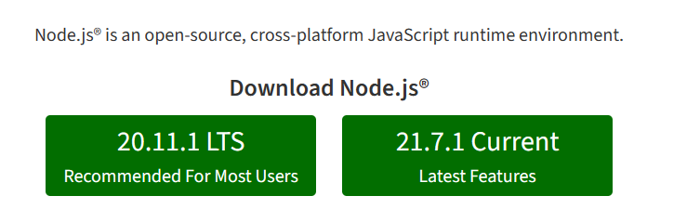
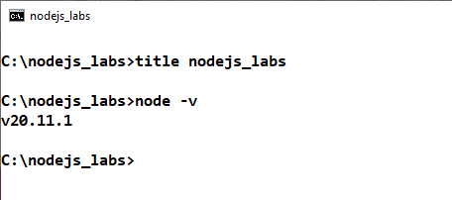
1.1. What is Node.js?
LinkedIn Lesson: Chapter 1 What is Node.js?
Node.js History
Installing Node.js
Using Visual Studio Code
WA3476 Liberty FSE Phase 3: Chapter 1 Introduction to Node.js
What is Node.js?
Node.js is a JavaScript platform based on V8 JavaScript Engine used to Build Scalable High Performance Java Script applications
Single threaded, Event-Driven, Non-Blocking file and network I/O !
Node.js (nodejs.org)
Let us Install Node.js !
Go to your lab machine
Create a directory for node.js labs, say C:\nodejs_labs
Open a Browser, go to Node.js (nodejs.org)
Download Node.js: Use LTS version
Install Node.js
How to verify Node.js installation?
Open a command terminal, type the command
node –v
© 2024 Web Age Solutions All rights reserved

Slide 3
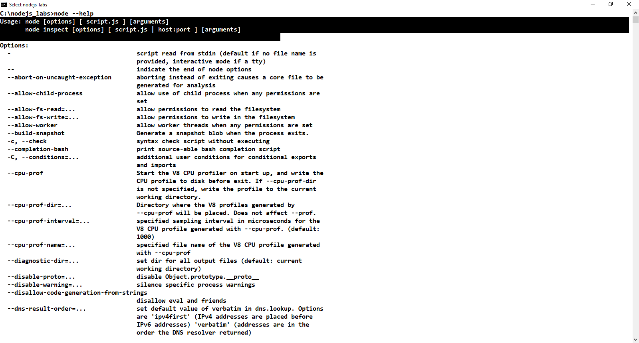
1.2 How to run Node applications?
© 2024 Web Age Solutions All rights reserved

Slide 4
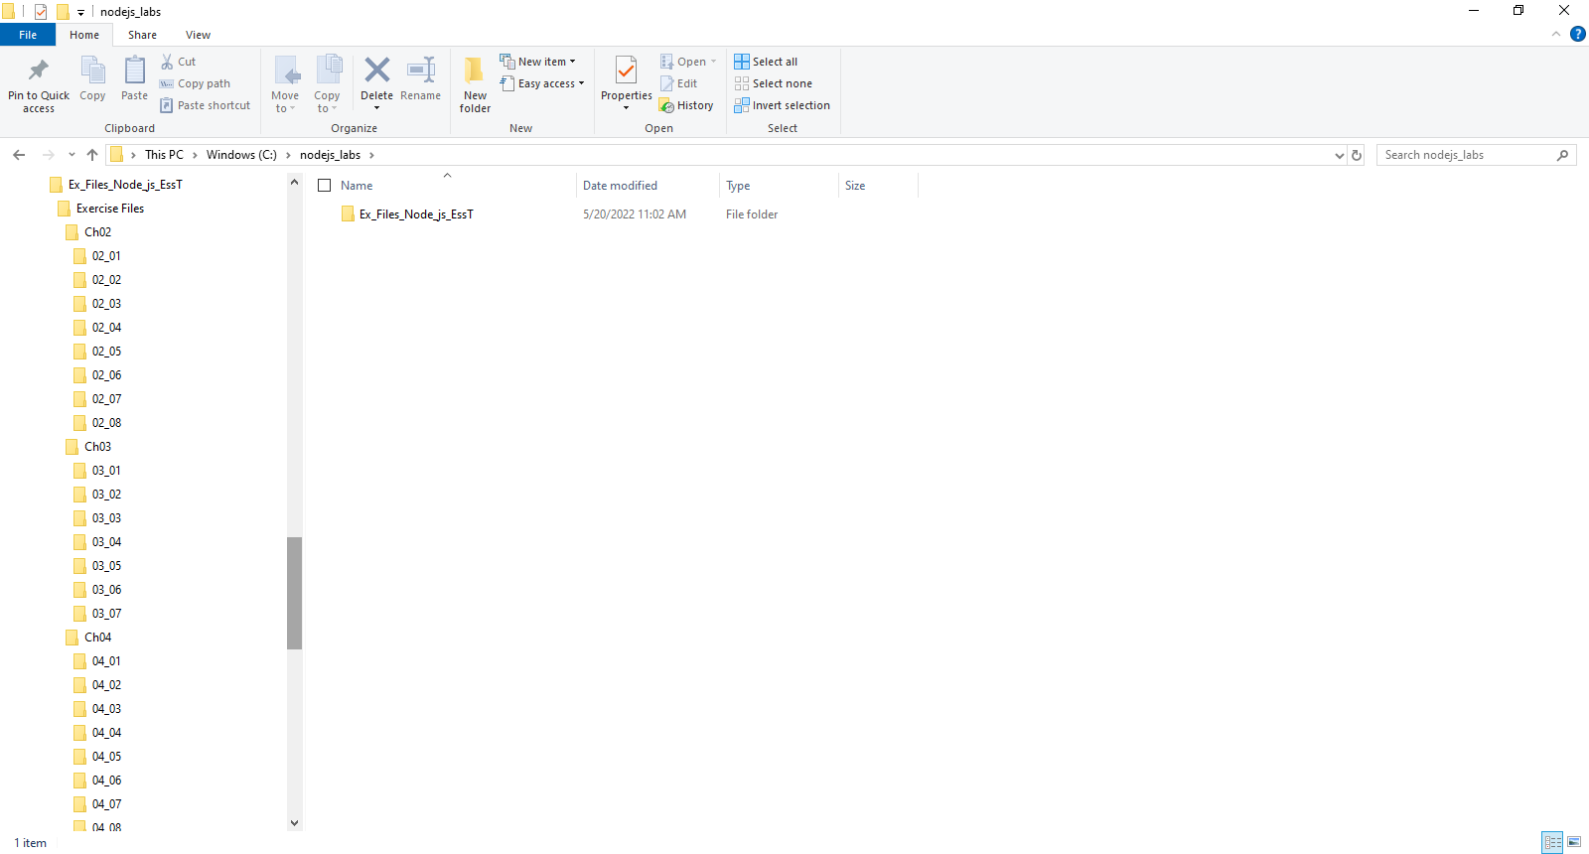
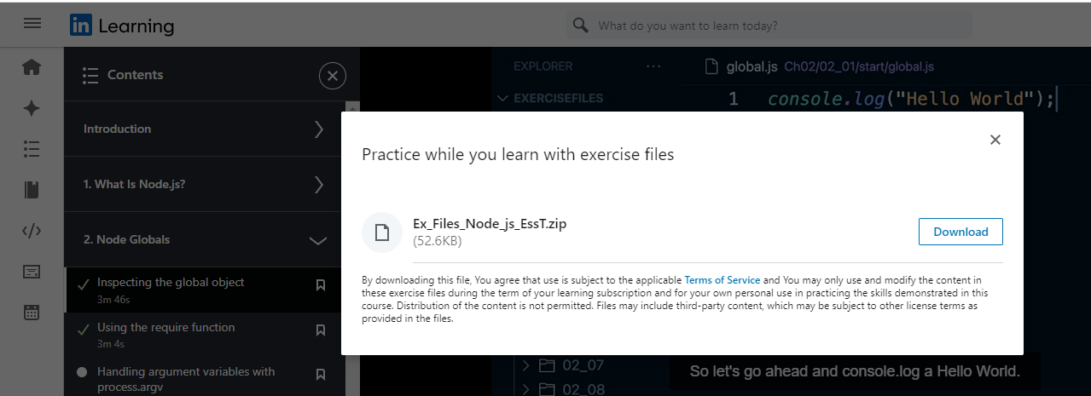
1.3 Exercises and Exercise Files
Use Visual Studio Code for all Hands-on activities
Install it and start VSCode
Download LinkedIn Materials Exercises Files
Ex_Files_Node_js_EssT.zip
Extract Exercises from Ex_Files_Node_js_EssT.zip into C:\nodejs_labs

Slide 5
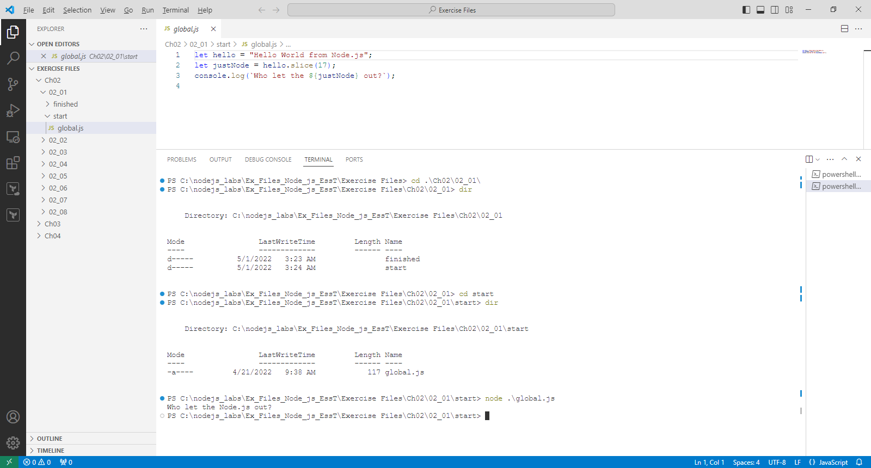
1.4 Using Visual Studio Code

Slide 6
Intro to Node
Chapter 2 – Node Globals

Slide 7
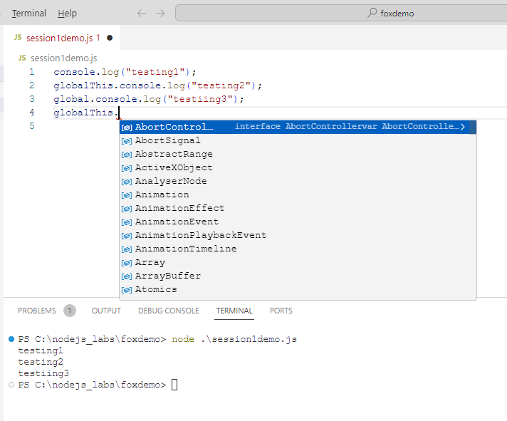
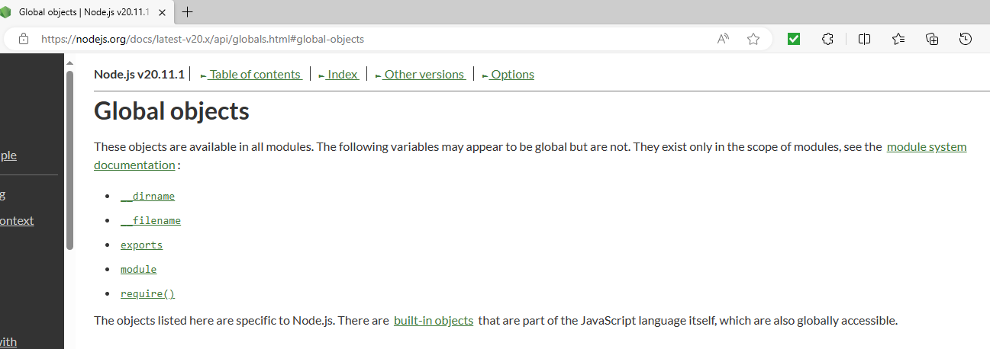
2.1. Inspecting the global object
Global Namespace
Classes, objects, and functions in global namespace
No need to import them
Access anytime
https://nodejs.org/docs/latest-v20.x/api/globals.html
Global objects | Node.js v20.11.1 Documentation (nodejs.org)
Exercise Files\Ch02\02_01\finished
C:\nodejs_labs\Ex_Files_Node_js_EssT\Exercise Files\Ch02\02_01\start
C:\nodejs_labs\Ex_Files_Node_js_EssT\Exercise Files\Ch02\02_01\finished
© 2024 Web Age Solutions All rights reserved

Slide 8
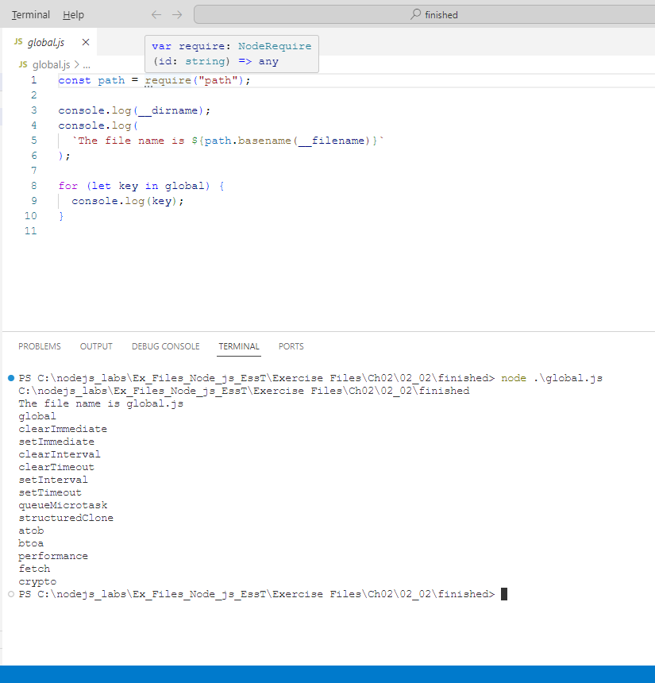
2.2. Using the require function
How to import modules into our application and use it?
One way is to use the require function
Used to import modules, JSON, and local files.
Modules can be imported from node_modules
https://nodejs.org/docs/latest-v20.x/api/modules.html#requireid
Examples
// Importing a local module with a path relative to the `__dirname` or current
// working directory. (On Windows, this would resolve to .\path\myLocalModule.)
const myLocalModule = require('./path/myLocalModule’);
// Importing a JSON file:
const jsonData = require('./path/filename.json');
// Importing a module from node_modules or Node.js built-in module:
const crypto = require('node:crypto');
C:\nodejs_labs\Ex_Files_Node_js_EssT\Exercise Files\Ch02\02_02\finished
© 2024 Web Age Solutions All rights reserved

Slide 9
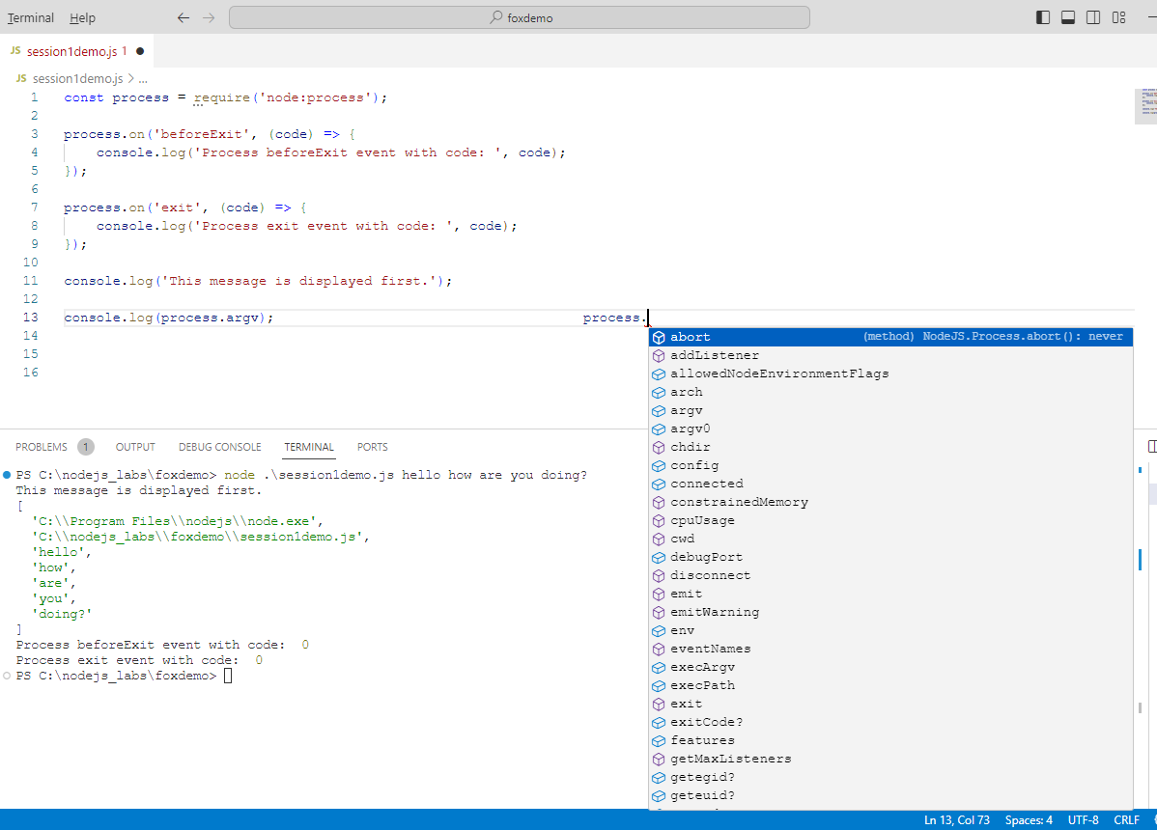
2.3. Using process.argv
The process object
Access it anywhere
Provides information about the current process instance
Environment data, communicate with the terminal, exit process
Process | Node.js v20.11.1 Documentation (nodejs.org)
Examples
const process = require('node:process');
process.on('beforeExit', (code) => {
console.log('Process beforeExit event with code: ', code);
});
process.on('exit', (code) => {
console.log('Process exit event with code: ', code);
});
console.log('This message is displayed first.');
C:\nodejs_labs\Ex_Files_Node_js_EssT\Exercise Files\Ch02\02_03\finished
© 2024 Web Age Solutions All rights reserved

Slide 10
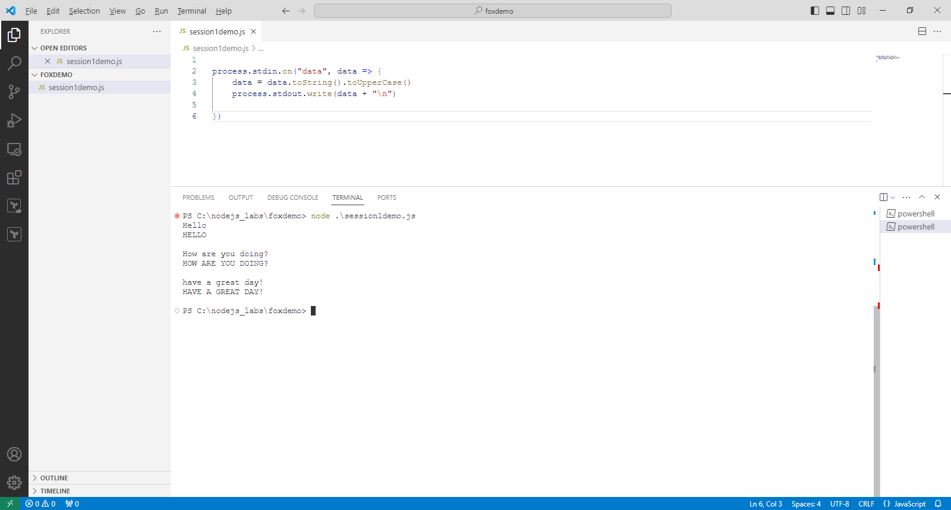
2.4. Standard Input and Output
Standard Input Stream
process.stdin
Source for input for the program
Standard Output Stream
process.stdout
Source for output for the program
Standard Error Stream
process.stderr
Error messages and diagnostic messages
Process | Node.js v20.11.1 Documentation (nodejs.org)
Examples
process.stdin.on("data", data => {
data = data.toString().toUpperCase()
process.stdout.write(data + "\n")
})
C:\nodejs_labs\Ex_Files_Node_js_EssT\Exercise Files\Ch02\02_04\finished
© 2024 Web Age Solutions All rights reserved

Slide 11
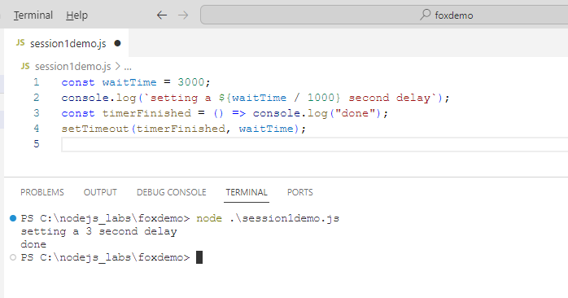
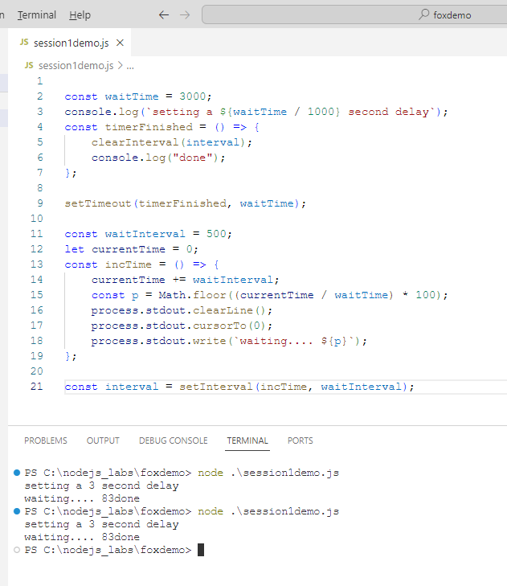
2.5. Timing Functions
Set Timeout
setTimeout
Set Interval
setInterval
Examples
const waitTime = 3000;
console.log(`setting a ${waitTime / 1000} second delay`);
const timerFinished = () => console.log("done");
setTimeout(timerFinished, waitTime);
C:\nodejs_labs\Ex_Files_Node_js_EssT\Exercise Files\Ch02\02_06\finished
C:\nodejs_labs\Ex_Files_Node_js_EssT\Exercise Files\Ch02\02_07\finished
C:\nodejs_labs\Ex_Files_Node_js_EssT\Exercise Files\Ch02\02_08\finished
© 2024 Web Age Solutions All rights reserved

Slide 12
Intro to Node
Chapter 3 – Node Modules

Slide 13
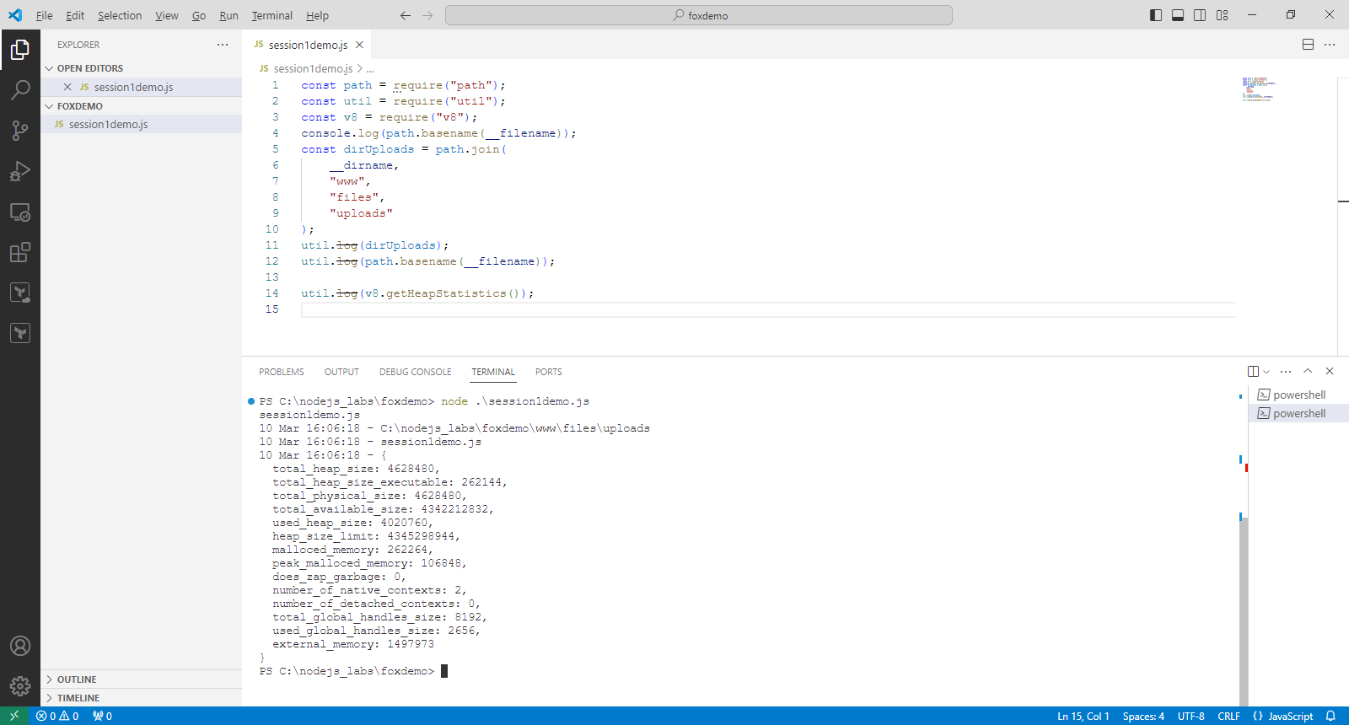
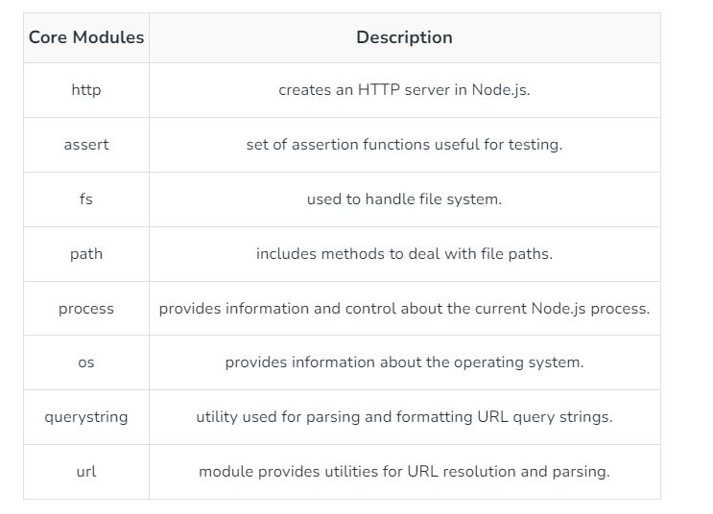
3.1. Node Core Modules
Node Modules
Core modules
Local Modules
Third Party Modules
https://www.geeksforgeeks.org/node-js-modules/
.
Core Modules:
Node.js has many built-in modules that are part of the platform and come with Node.js installation.
These modules can be loaded into the program by using the required function
C:\nodejs_labs\Ex_Files_Node_js_EssT\Exercise Files\Ch02\02_01\finished
© 2024 Web Age Solutions All rights reserved

Slide 14
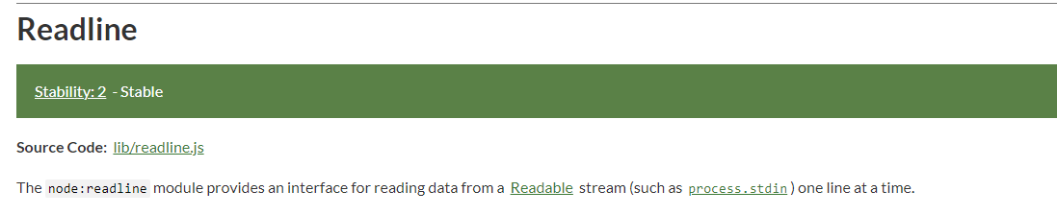
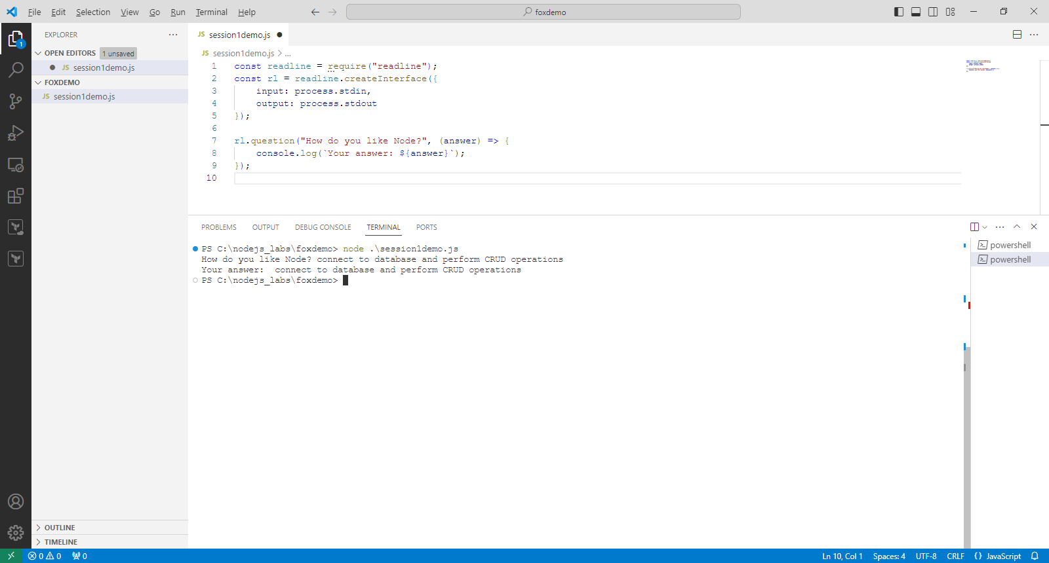
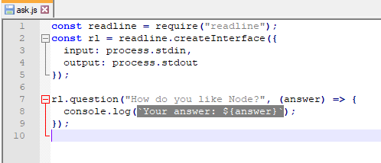
3.2. readline module
readline module
https://nodejs.org/docs/latest-v20.x/api/readline.html#readline
Example
C:\nodejs_labs\Ex_Files_Node_js_EssT\Exercise Files\Ch03\03_02\finished
© 2024 Web Age Solutions All rights reserved

Slide 15
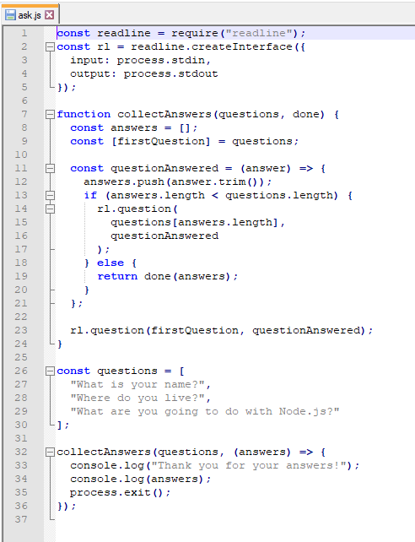
3.3. Using readline: Example
Example using readline
C:\nodejs_labs\Ex_Files_Node_js_EssT\Exercise Files\Ch03\03_03\finished
© 2024 Web Age Solutions All rights reserved

Slide 16
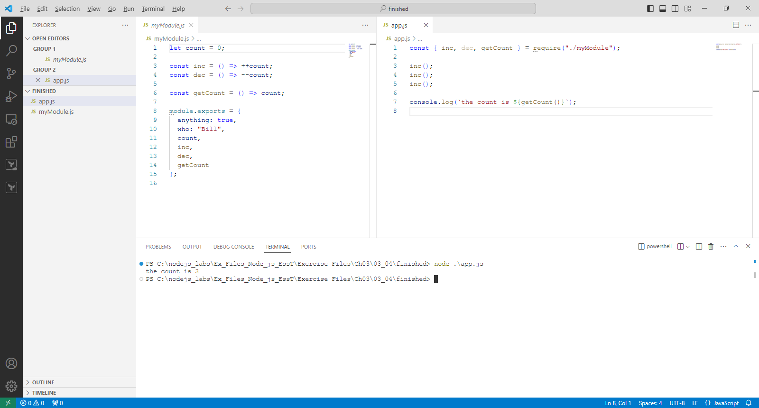
3.4. Export Custom Module
C:\nodejs_labs\Ex_Files_Node_js_EssT\Exercise Files\Ch03\03_04\finished
© 2024 Web Age Solutions All rights reserved

Slide 17
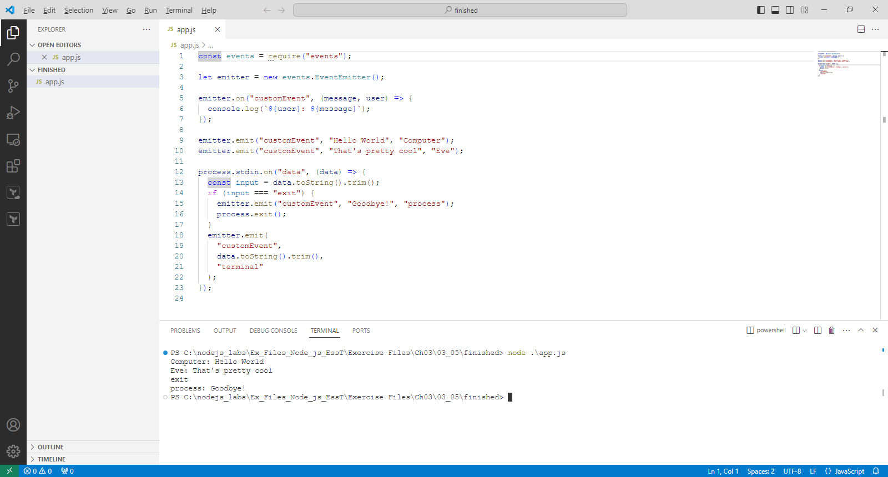
3.5. Using EventEmitter
C:\nodejs_labs\Ex_Files_Node_js_EssT\Exercise Files\Ch03\03_05\finished
© 2024 Web Age Solutions All rights reserved

Slide 18
Intro to Node
Chapter 4 – File Management and Streams

Slide 19
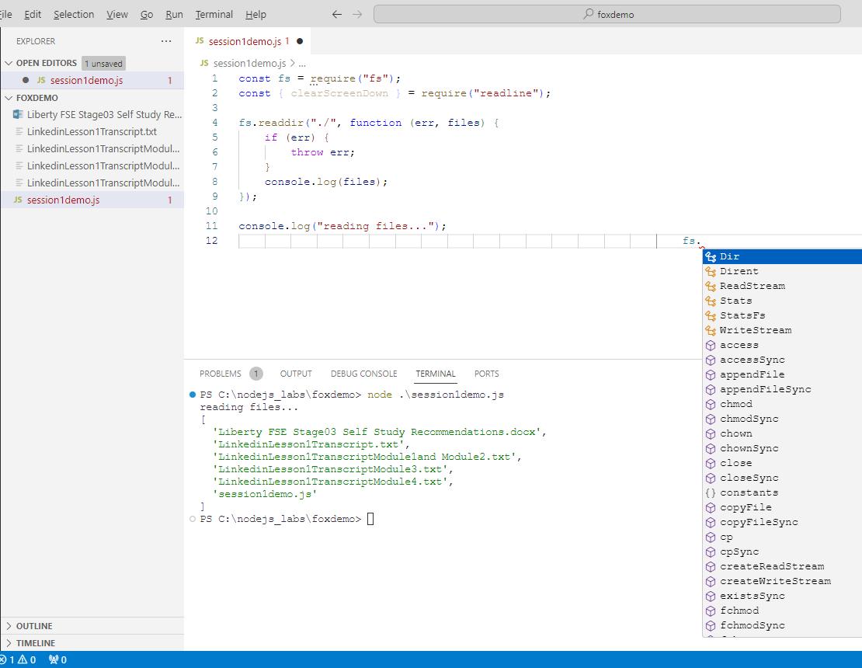
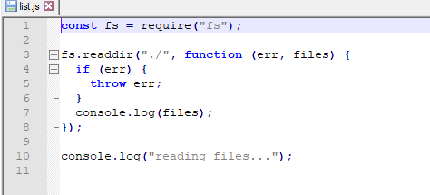
4.1. Listing Directory Files
The Fs module
List files and directories
Create files and directories
Stream files
Change file permissions
https://nodejs.org/docs/latest-v20.x/api/fs.html
C:\nodejs_labs\Ex_Files_Node_js_EssT\Exercise Files\Ch04\04_01\finished
© 2024 Web Age Solutions All rights reserved

Slide 20
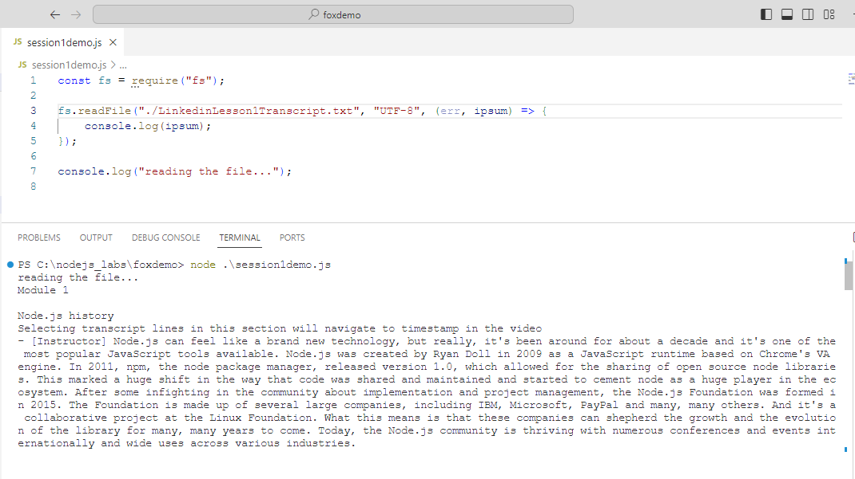
4.2 Reading Files
C:\nodejs_labs\Ex_Files_Node_js_EssT\Exercise Files\Ch04\04_02\finished
© 2024 Web Age Solutions All rights reserved

Slide 21
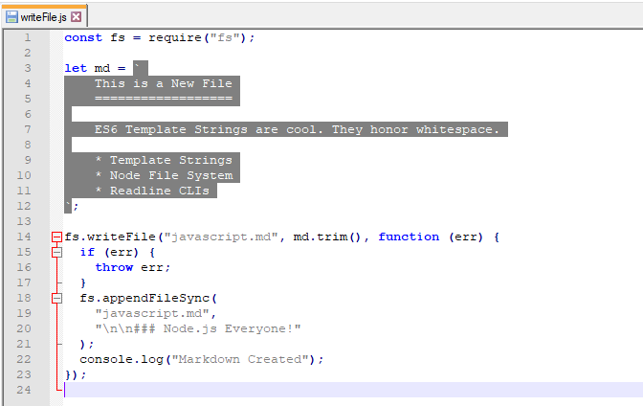
4.3 Writing and appending files
C:\nodejs_labs\Ex_Files_Node_js_EssT\Exercise Files\Ch04\04_03\finished
© 2024 Web Age Solutions All rights reserved

Slide 22
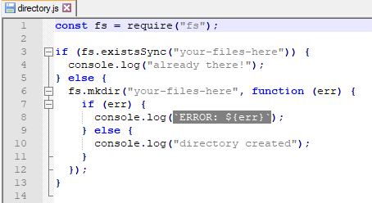
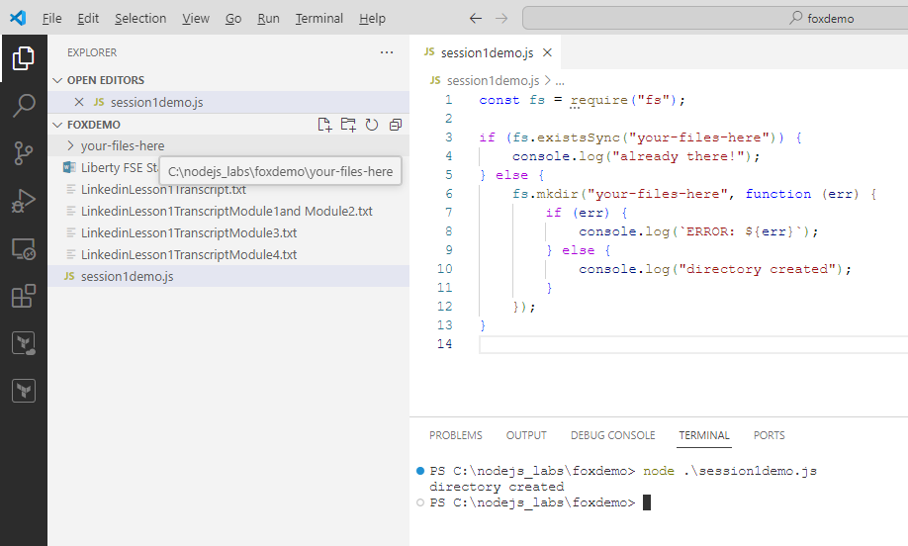
4.4 Create directories
C:\nodejs_labs\Ex_Files_Node_js_EssT\Exercise Files\Ch04\04_04\finished
© 2024 Web Age Solutions All rights reserved

Slide 23
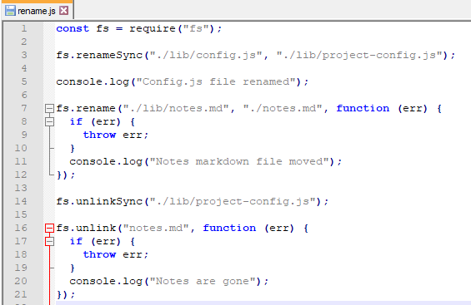
4.5 Rename and Remove files
C:\nodejs_labs\Ex_Files_Node_js_EssT\Exercise Files\Ch04\04_05\finished
© 2024 Web Age Solutions All rights reserved

Slide 24
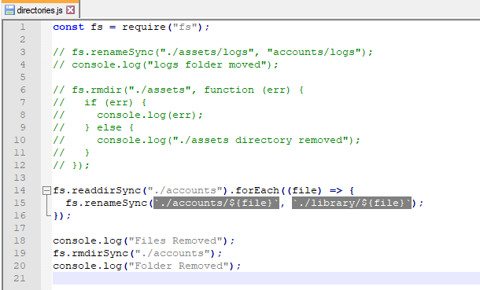
4.6 Rename and Remove directories
C:\nodejs_labs\Ex_Files_Node_js_EssT\Exercise Files\Ch04\04_06\finished
© 2024 Web Age Solutions All rights reserved

Slide 25
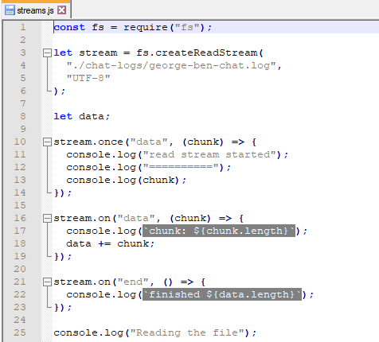
4.7 Readable file streams
C:\nodejs_labs\Ex_Files_Node_js_EssT\Exercise Files\Ch04\04_07\finished
© 2024 Web Age Solutions All rights reserved

Slide 26
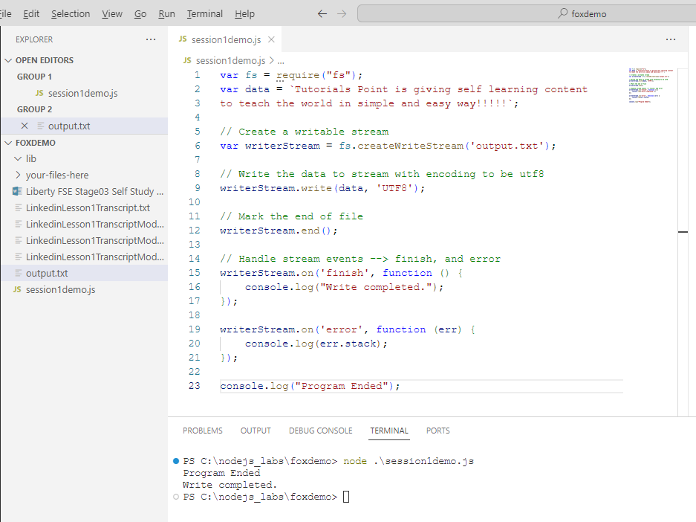
4.8 Writable file streams
C:\nodejs_labs\Ex_Files_Node_js_EssT\Exercise Files\Ch04\04_08\finished
© 2024 Web Age Solutions All rights reserved

Slide 27
Intro to Node
WA3476 Liberty FSE Phase 3

Slide 28
WA3476 Liberty FSE Phase 3 Chapter 1
Chapter 1 - Introduction to Node.js.....................................................................................5
1.1 What Is Node.js?......................................................................................................5
1.2 Applications of Node.js............................................................................................6
1.3 Installing Node.js and NPM.....................................................................................6
1.4 "Hello, Node World!"..............................................................................................7
1.5 How It Works...........................................................................................................7
1.6 Node.js is built on JavaScript: Benefits...................................................................8
1.7 Traditional Server-Side I/O Model..........................................................................8
1.8 Disadvantages of the Traditional Approach.............................................................9
1.9 Event-Driven, Non-Blocking I/O.............................................................................9
1.10 Concurrency.........................................................................................................10
1.11 Using Node Package Manager (NPM).................................................................10
1.12 The Express Server Framework...........................................................................10
1.13 Summary..............................................................................................................11
© 2024 Web Age Solutions All rights reserved

Slide 29
WA3476 Liberty FSE Phase 3 Chapter 2
Chapter 2 - The File System Module.................................................................................13
2.1 Introduction............................................................................................................13
2.2 Basic File Manipulation.........................................................................................14
2.3 Getting File/Directory Meta Data..........................................................................14
2.4 Read an Entire File.................................................................................................15
2.5 The Buffer Class....................................................................................................15
2.6 Writing to a File.....................................................................................................16
2.7 Reading in Chunks.................................................................................................16
2.8 Writing in Chunks..................................................................................................17
2.9 The open() Method.................................................................................................17
2.10 Stream API...........................................................................................................18
2.11 The Readable Interface........................................................................................19
2.12 Example Reading Data in Chunks.......................................................................19
2.13 The Writable Interface.........................................................................................19
2.14 Summary..............................................................................................................20
© 2024 Web Age Solutions All rights reserved

Slide 30
Additional Reading and Examples to Play
https://www.geeksforgeeks.org/nodejs/
https://www.geeksforgeeks.org/node-js-examples/
https://www.w3schools.com/nodejs/
https://www.w3schools.com/nodejs/nodejs_get_started.asp
https://www.w3schools.com/nodejs/nodejs_modules.asp
https://www.w3schools.com/nodejs/nodejs_filesystem.asp
https://nodejs.org/en/learn/getting-started/introduction-to-nodejs
https://www.netguru.com/blog/top-companies-used-nodejs-production
https://www.tutorialsteacher.com/nodejs/what-is-nodejs
© 2024 Web Age Solutions All rights reserved

